Slide 1
UML
Week 4-5-6-7 Extra Resource - 2
Khayyam H. MASIYEV
BHOS☺
Information Security Division
Senior Lecturer
khayyam.masiyev@bhos.edu.az

Slide 2
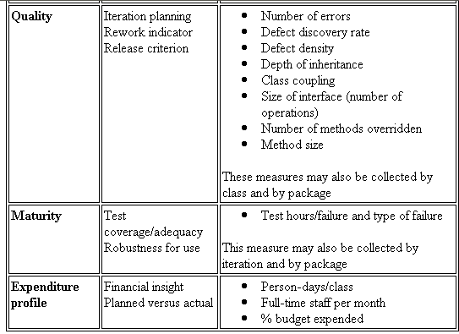
UML Diagram – What is UML?
The Unified Modeling Language (UML) is a standard language for
Specifying
Visualizing
Constructing
Documenting
Business Modeling
Communications

Slide 3
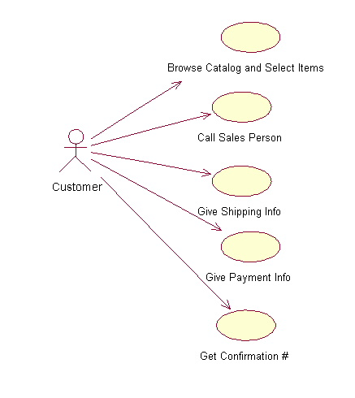
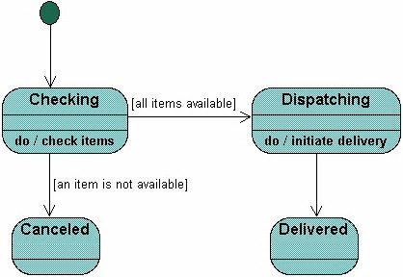
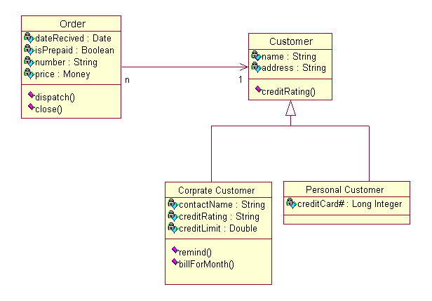
Different Views
Users
Designers
Analyzers

Slide 4
Use case diagram
System boundary
Actor
overview the usage requirements
presentations project stakeholders
"the meat" of the actual requirements
Use case:
A use case describes a sequence of actions that provide something of measurable value to an actor and is drawn as a horizontal ellipse
System boundary:
indicates the scope of your system. Anything within the box represents functionality that is in scope and anything outside the box is not
Actor:
An actor is a person, organization, or external system that plays a role in one or more interactions with your system
Use case
Online C2C shopping

Slide 5
Class Diagram
Name
Class diagrams show the classes of the system, their interrelationships (including inheritance, aggregation, and association), and the operations and attributes of the classes.
Associations
Aggregation
Generalization
Relations
Attributes
Operations

Slide 6
Relationships between Class Diagrams
Association -- a relationship between instances of the two classes. There is an association between two classes if an instance of one class must know about the other in order to perform its work. In a diagram, an association is a link connecting two classes.
Aggregation -- an association in which one class belongs to a collection. An aggregation has a diamond end pointing to the part containing the whole.
Generalization -- an inheritance link indicating one class is a superclass of the other. A generalization has a triangle pointing to the superclass.

Slide 7
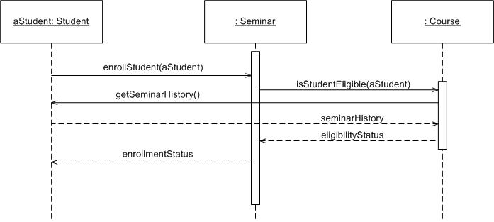
Sequence Diagram
Object: Class
A sequence diagram is
An interaction diagram that details how operations are carried out.
What messages are sent and when.
Sequence diagrams are organized according to time
Message
Operations
Lifeline

Slide 8
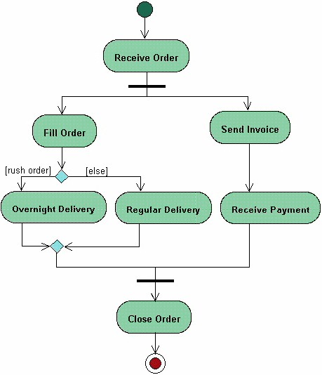
Activities Diagram
Start
Activity diagrams describe the workflow behaviour of a system
Fork
Branch
Merge
Joint
End

Slide 9
State Machine Diagram
A State Machine diagram
shows the possible states of
the object and the transitions
that cause a change in state.
?
What is different between activities and Statemachine diagram

